Slide 1
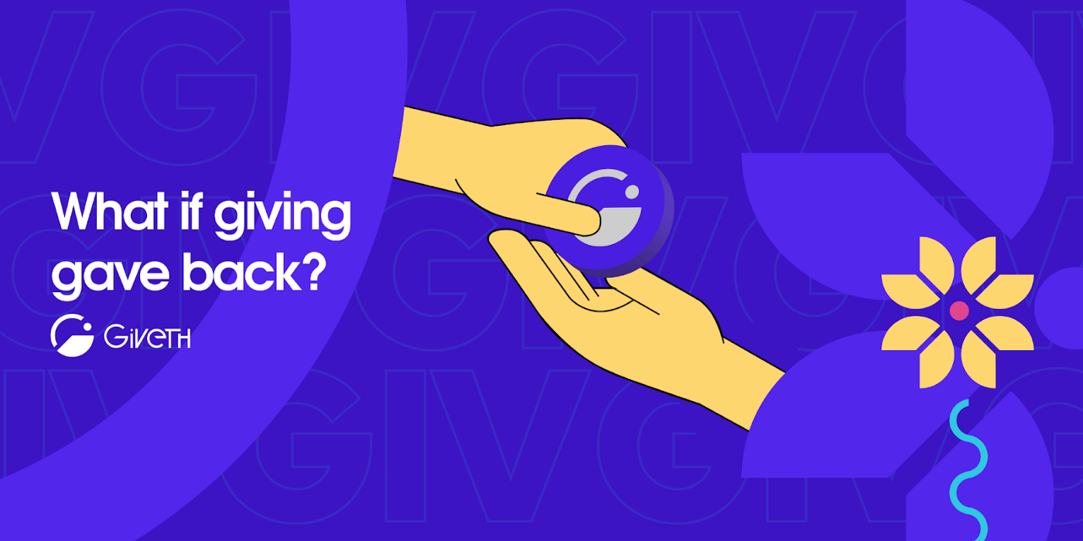
Giveth is rewarding and empowering those who give to projects, to society, and to the world!
with zero added fees

Slide 2
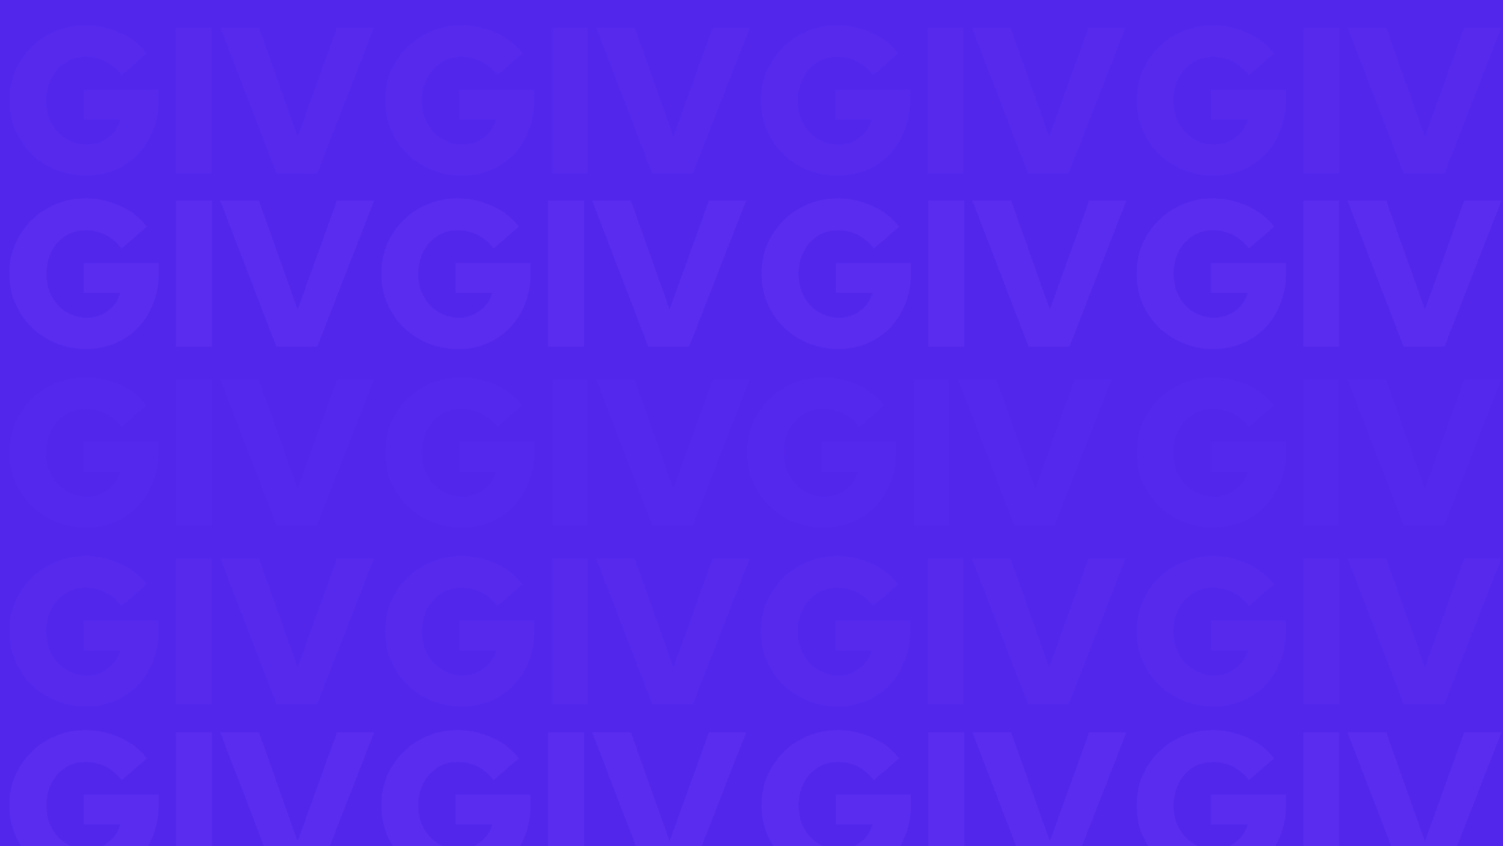

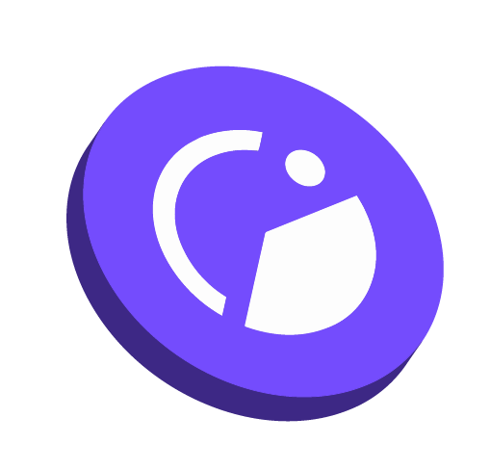




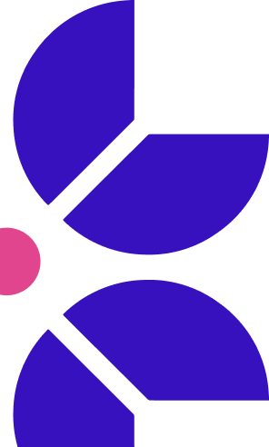


Using web3 to evolve philanthropy
Giveth is the best donation platform in the world!
Donations to projects where they keep 100% of proceeds.
Donors rewarded with GIVbacks. (incentive program that rewards donors in GIV tokens.)
Investors to earn a yield by participating in the GIVeconomy.
Organizations to participate in ReFi liquidity through Regen Farms.
Our community is focused on Building the Future of Giving using blockchain technology. Our intention is to support and reward the funding of public goods by creating open, transparent and free access to the revolutionary funding opportunities available within the web3 ecosystem.

Slide 3
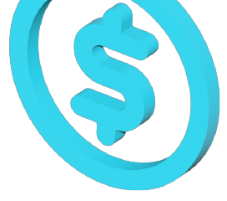

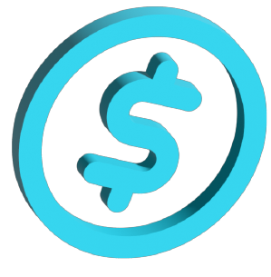
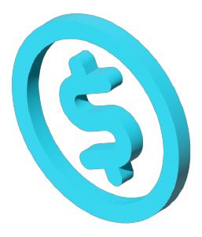


The Opportunity
$10.5 Trillion/yr
In the US Alone Over 10x Total Crypto Market Cap
Griff Green @thegrifft

Slide 4
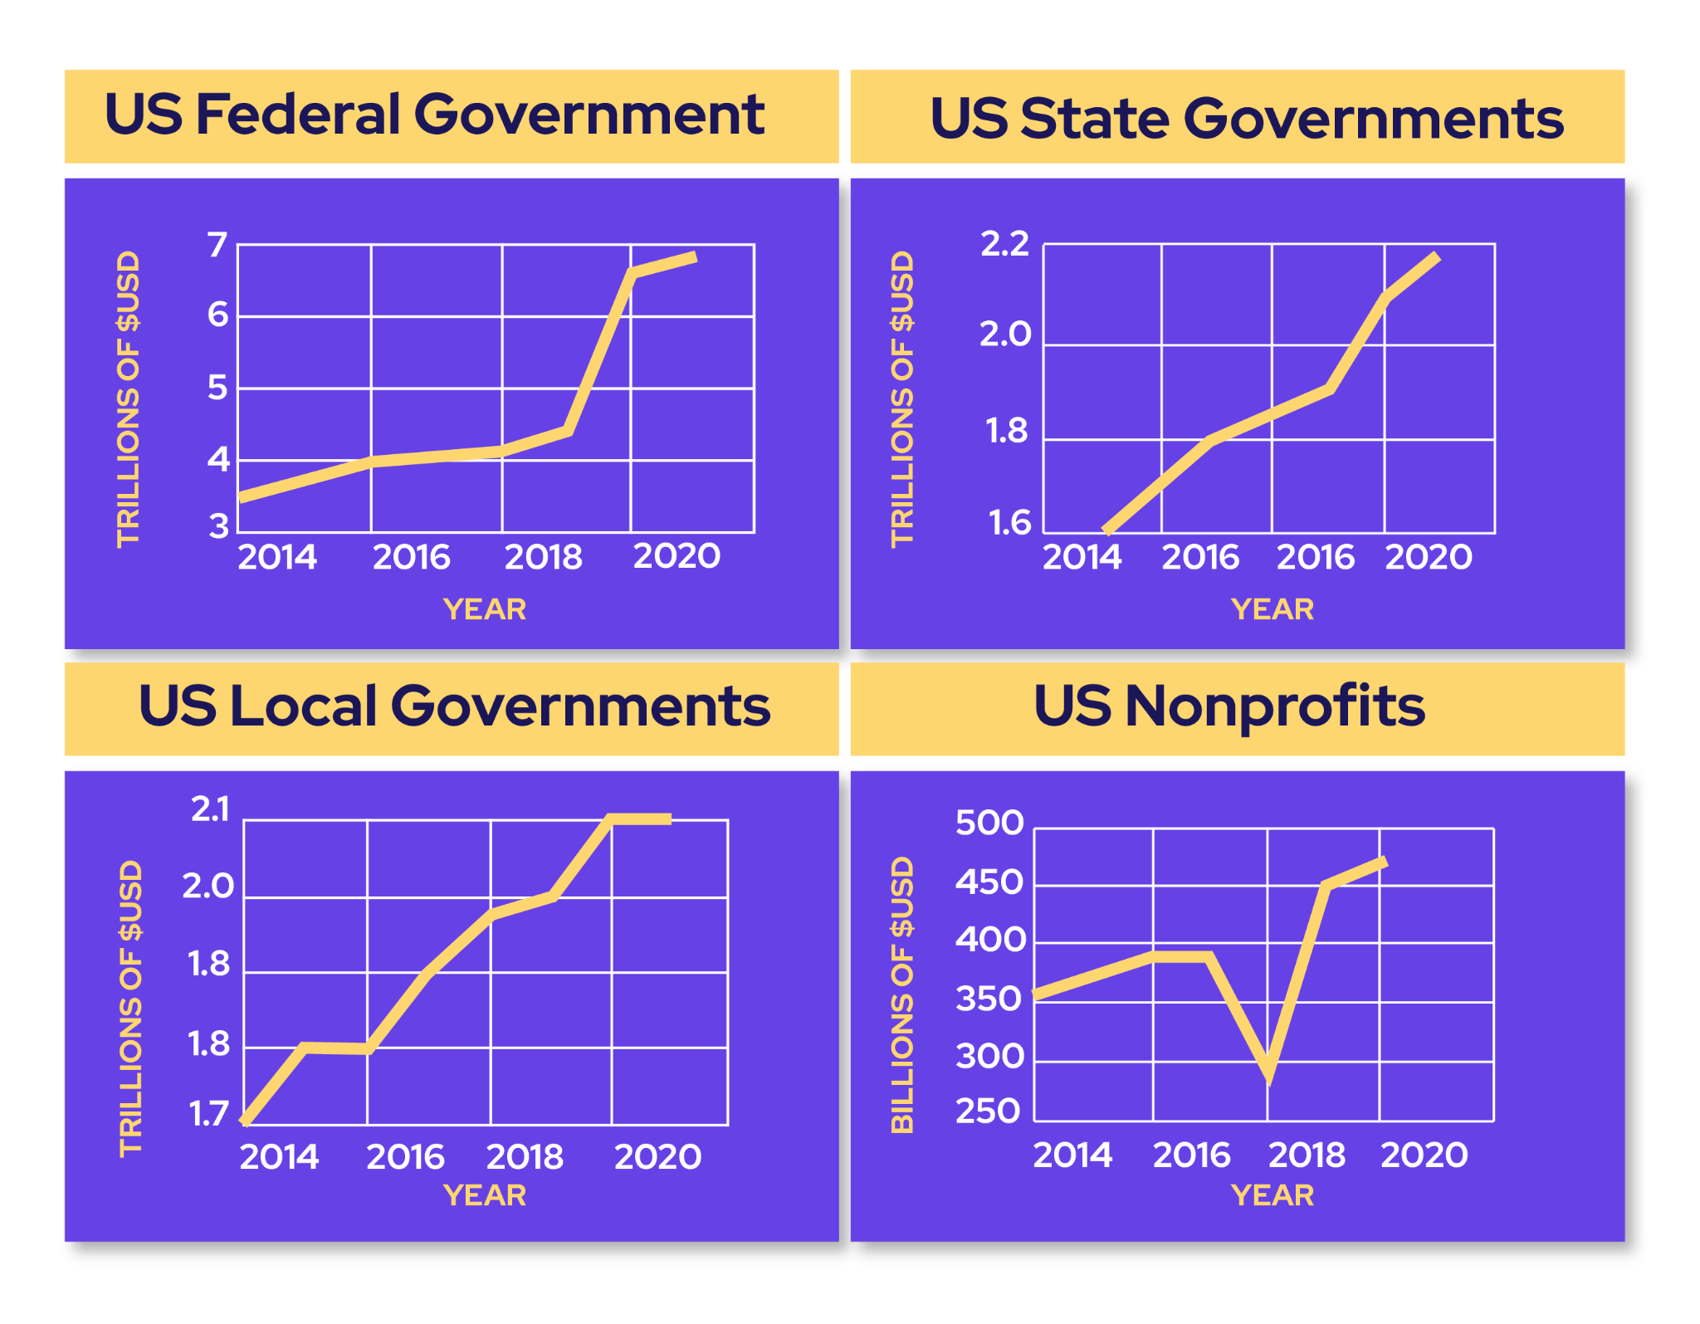
The right time for disruption is NOW!
Public goods are the most overlooked web3 opportunity.
Federal, state, and local governments in just the US spent $10 TRILLION in 2021 and this cost is growing every year with no clear solution in sight: 10x the crypto market cap, not invested, SPENT!
US philanthropists donated almost 500B USD in 2020 but our collective needs aren’t being adequately met using these systems.
We have the opportunity to disrupt this sector GLOBALLY & Giveth is positioned to lead the way.

Slide 5
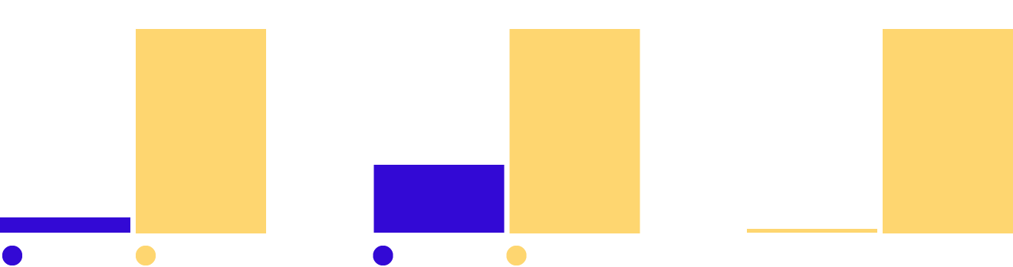
45% of crypto users donate at least $1,000 to charity each year…
…while only 33% of the general investor population gives $1,000 or more to charity annually. Suggesting the average crypto donor is uniquely generous, as compared to the average cash donor.
Given the crypto market outlook, user and nonprofit adoption growth, and innovations in fundraising, crypto has the potential to become the most powerful philanthropic force on the planet in the years ahead.
In 2021, the largest source of charitable giving came from individuals, who gave $326.87 billion, representing 67% of total giving.
Overall Cryptocurrency Donation Volume
Total Annual Volume of Cryptocurrency Donations (USD)
The Value of an Average Crypto Donation
Mean Average Cryptocurrency Donation Size
Donations: Crypto vs. Cash
Average Cryptocurrency Donation vs. Average Online Cash Donation
+16x
+236%
+82x
Source: 1. Growing popularity of cryptocurrency could fuel charitable giving (Fidelity Charitable) 2. Charitable Giving Statistics 3. The giving block annual report

Slide 6
The next generation of ReFi Opportunities
Giveth is re-engineering charitable giving by creating an entirely free, open-source platform, built on Ethereum.
RegenFarms is the next generation of ReFi liquidity mining opportunities for DAOs and regens alike. Using our contracts for the GIVfarm and the GIVstream, we are empowering other for-good DAOs to launch liquidity mining incentive programs, “RegenFarms”, with streams of their own.
Shapeshift & CultDAO have both paid to be part of this farm.

Slide 7

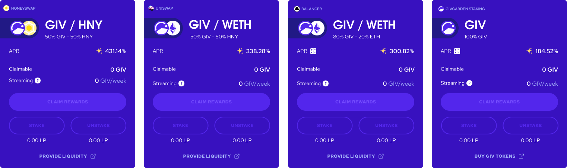
Giveth offers lucrative rewards to donors while attracting and rewarding long-term hodlers
The GIVfarm provides 4 liquidity farms - 2 on Mainnet and 2 on Gnosis chain - as well as single asset GIV staking on both chains. APRs range from 200% to 450%.
The GIVstream is another novel concept pioneered by Giveth. When you harvest rewards from the GIVfarm you are not only earning instantly claimable rewards but also receiving and augmenting your own personal continuous stream of GIV.

Slide 8
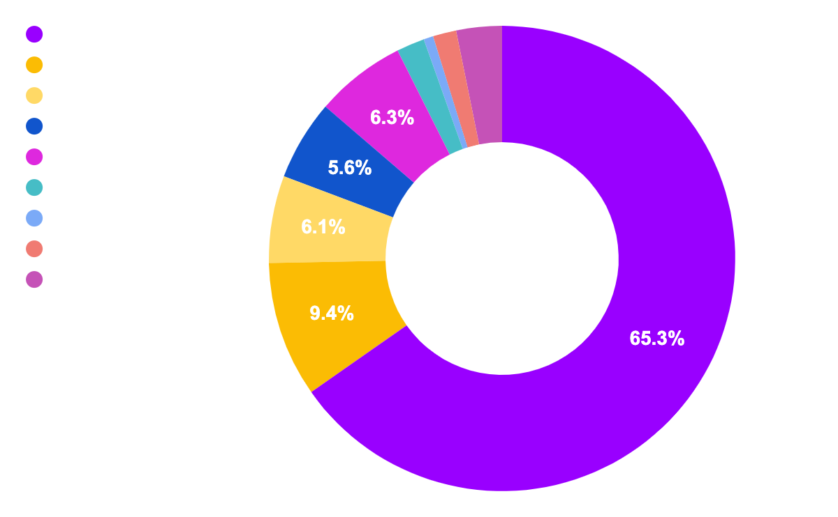
86% of our unique donors joined since March ‘21 and growing!
Giveth in numbers
Total donated: $3,093,149
# of projects: 1,562
# of donations: 14,327
# of unique donors: 4,168
$ 3,093,149
Total
Top 10 categories raised by total

Slide 9
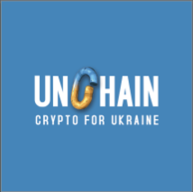
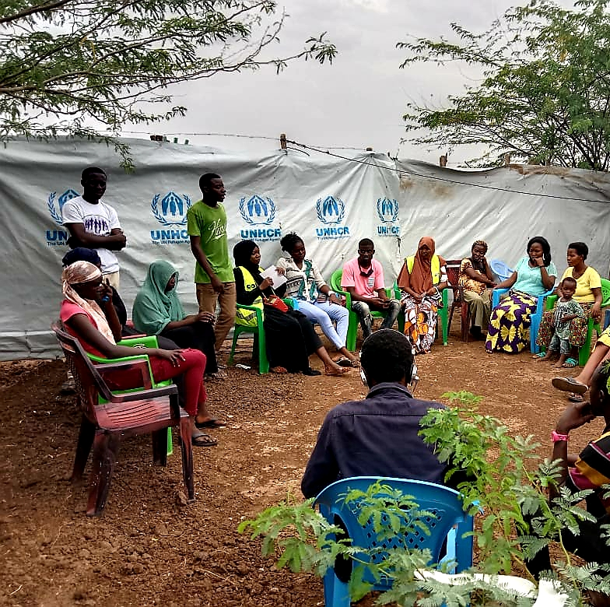

How we are making an impact
Unchain Fund
(Humanitarian)
Total raised: $+150,000
Humanitarian and non-military support to Ukraine. Clothes, food and shelter for people whose life had dramatically changed.
Grassroots Economics Community Currency
(Inclusion/web.30)
Total raised: $+18,000
Seeks to connect people to their own abundance by supporting them in creating their own Community Inclusion Currencies - which are blockchain based Vouchers backed by the goods and services of community groups in vulnerable communities in Kenya and growing to other countries.
Colorado Multiversity
(Environment)
Total raised: $+100,000
Aims to contribute to Costa Rica's transition to a green and intelligent society paradigm, following the guidelines of the National Climate Change Strategy (ENCC) and the Decarbonization Plan.

Slide 10
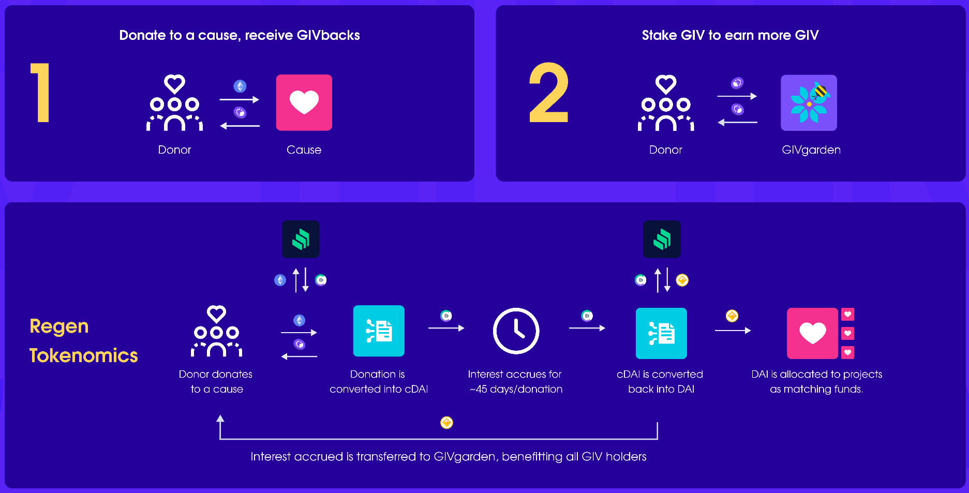
The GIVeconomy Future - next phase of the future of giving
GIVpower
Community members will be able to stake GIV (using GIVpower) on their favorite projects on Giveth.
GIVmatching
Donation matching to projects on Giveth using "Causes" through quadratic funding.
Causes will be for-good initiative categories such as environmental regeneration, digital public goods, social causes, etc.
GIVfi
Create a sustainable way of maintaining funds in the GIVgarden common pool. Generating interest while donations on the DApp are waiting to be disbursed.

Slide 11

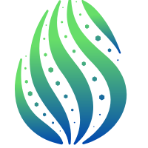
History of Success
‘16
‘17
‘18
‘19
‘20
‘21
• Founded by Griff Green, Jordi Baylina, and members of the White Hat Group
• Created Minime Token contract (used by Aragon, Status, etc and forked by Compound)
• First project website launch
• Donation Application (DApp) is launched - enabling traceable & accountable donations to for-good campaigns
• Giveth is officially introduced as a DAC and built and introduced a new governance structure for the DAO
• The Reward DAO (a system to reward contributors for their work, now called Praise)
• Organized the ScalingNow! Conference to address Ethereum Scaling issues
• Won the 1st place at Edcon’s Super Demo in Toronto
• Launched Giveth Trace, with a bridge to Rinkeby
• Supported the launch of xDai, being one of 4 initial validators
• Commons Stack is launched. A partner project designed to help with Giveth’s vision of Regenerative Microeconomies
• Augmented Bonding Curve was designed
• Conviction Voting was designed
• Work began on building the Token Engineering Commons
• Launched The new
“Giveth TRACE” with better functionality and streamlined UX
• Built a new donation application with simple peer-to-peer donations on both Mainnet and xDai network
• Launch of GIVecnomy and GIV token. GIVfarm, GIVstream and Regenfarms are live
• Giveth is in full-swing and tokenization platform is working…

Slide 12
Our growth plan - the best is yet to come
Angel Vault and path to our stable token (oneGIV)
To create more liquidity, we are planning to launch $oneGIV and make Giveth Angel Vault. This way we can protect the value of $GIV for GIVbacks, the GIVgarden & all our future ventures. $oneGIV, our own branded stablecoin will be used throughout the GIVeconomy.
2022
GIVpower
$GIV holders will be able to lock their tokens to BOOST projects asking for donations on our platform. The longer they lock, the more the project is BOOSTED and the higher their staking APR.
2022
GIVfi
Latent donations on the platform will be put into safe defi strategies to earn an interest while waiting for projects to withdraw them. This interest will be used to buy $GIV on secondary markets.
2023
Regen Microeconomies powered by $GIV
With the $GIV staked behind projects via GIVpower, we can enable for-good projects to launch their own microeconomies backed by $GIV in a Bonding Curve. Donors become investors, Volunteers become shareholders with a voice, Giveth.io becomes the place to go for seed round impact investments. The Future of Giving, is Investing.
Future

Slide 13
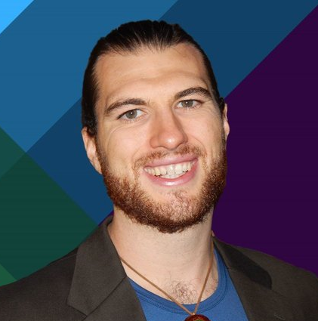


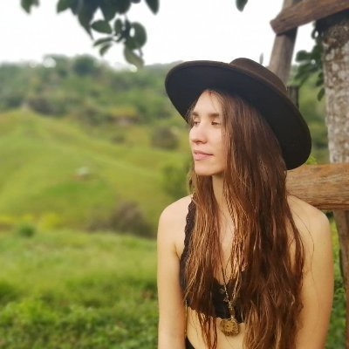
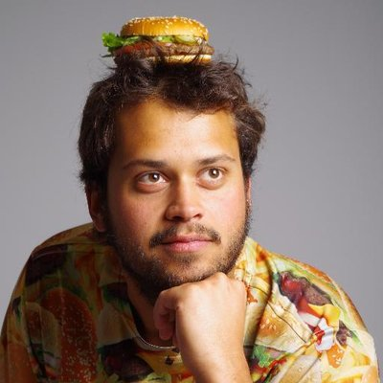


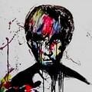
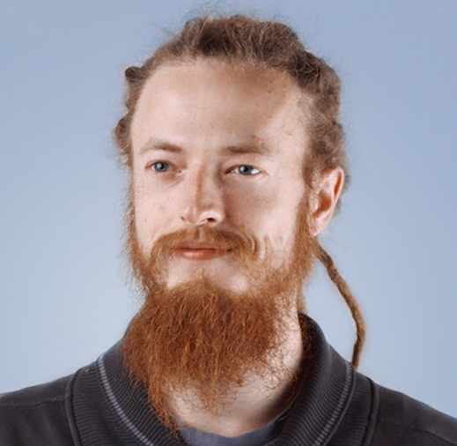
Giveth DAO
Griff Green
co-Founder of The Commons
Stack, Giveth.io. Also co-founded DAppNode and White Hat Group (WHG).
Jordi Baylina
co-founder of Giveth, DAppNode
and Founder and Technical Lead of Hermez Network and iden3.
Marko Prljic
Product and UX Design Lead at
Giveth, Founding member of General Magic.
Lauren Luz
Giveth communications lead and GIVeconomy product manager.
Mitch @divine_comedian
DAO Steward, DeGov Expert,
DevOps and Development Assistant.
Willy Ogorzaly
Head of Decentralization at Fox Foundation. Former CEO @bitfract acq: ShapeShift @JustLegal acq: DigitalTown.
Eduardo Antuña
DAppNode co-founder and
project lead. Ethereum DevOps and Solidity developer.
Sem @404ouch
Software engineer at 1Hive, Giveth.
Smart contract developer. Building GIVpower.
Oleksii Matiiasevych
Ethereum architect,
Smart Contracts Engineer.
…and 40+ Giveth contributors

Slide 14



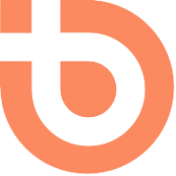
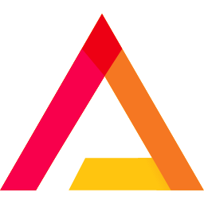

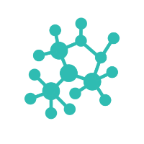
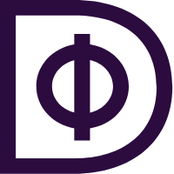

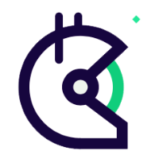


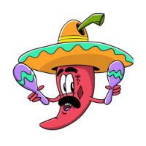
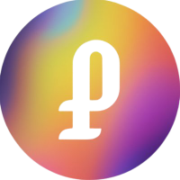

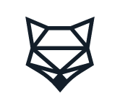
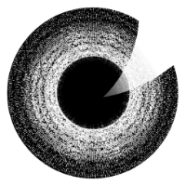
Our partners
1Hive
Alibre
Aragon
BrightID
Change
clr.fund
DappNode
Datafund
distrix0x
Gitcoin
Governauts
Maker DAO
Meta Cartel
Panvala
PrimeDAO
ShapeShift DAO
The Commons Stack
The DAOIst
The Engineering Commons
and more…

Slide 15

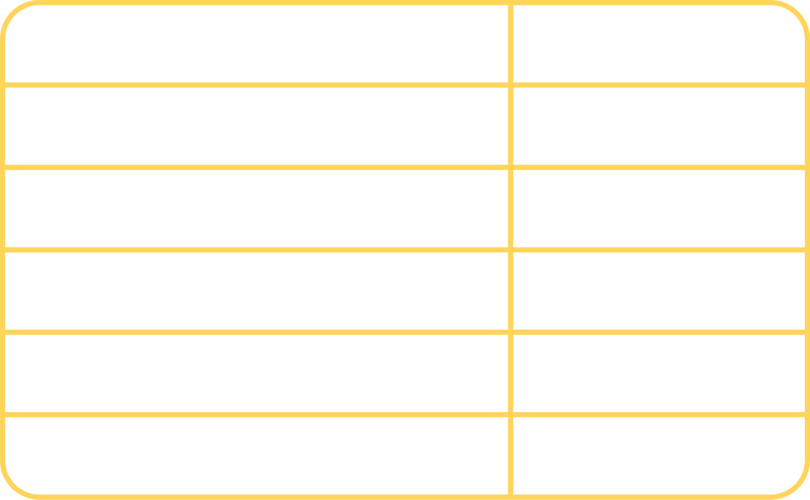
We are raising 3,000,000 USD
We are offering a chance to participate in this round in either or a combination of the following ways:
Buy $GIV at a discounted rate and stake it with a higher reward in our GIVfarm.
GIV Smart tokens - these are "crypto native convertible debt" which provides value to the investor when the token expires above the strike value. Read more.
If you are a DAO or have your own tokens - we often pursue DAO-to-DAO collaboration and token swaps which align with Giveth’s mission and vision.
Staking Pools
Chain
80GIV/20ETH Balancer
Mainnet
GIV/DAI UniV2
Mainnet
GIV/xDAI Honeyswap
Gnosis Chain
GIV/WETH Sushiwap
Gnosis Chain
Single-sided GIV Staking
Mainnet & Gnosis

Slide 16

Join us in Building the
Future of Giving

Slide 17
APPENDIX
GIVeconomy & Token Info
GIVdrop
GIVbacks
GIVstream
GIVgarden
GIVfarm
Regen farms

Slide 18
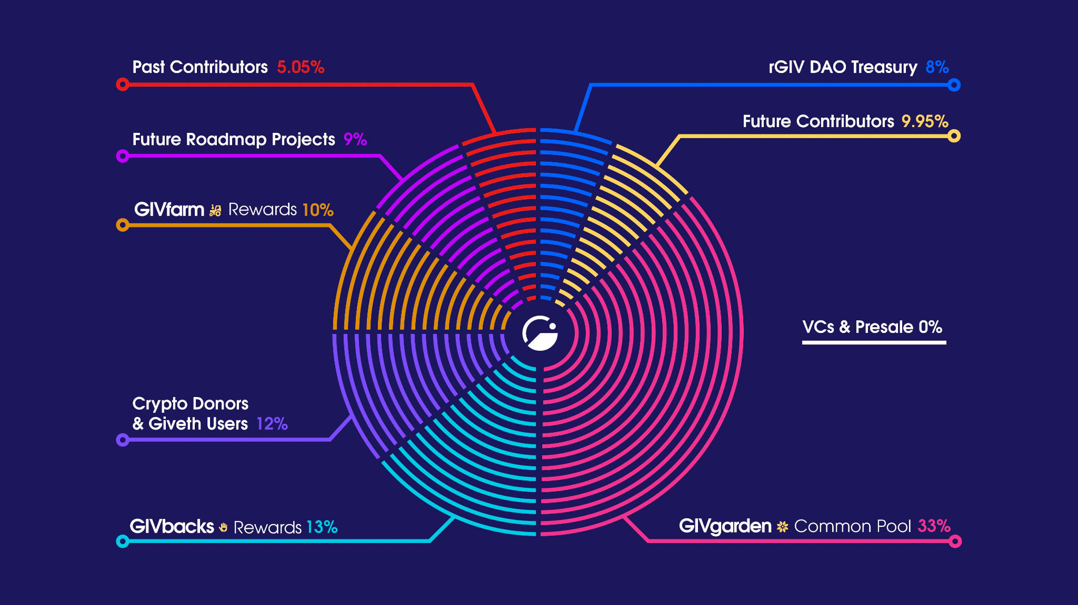
GIV is the governance token that fuels and directs the GIVeconomy
Our community can participate in the GIVeconomy in the following ways:
From December 24, 2021 onward, eligible recipients can claim their GIVdrop on Gnosis Chain.
Donors to verified projects on Giveth get rewards from GIVbacks.
Liquidity providers and stakers can earn rewards in the GIVfarm.
All GIV holders can create and/or vote on proposals in the GIVgarden.
Anyone who claims GIV from their participation in the GIVeconomy gets a continuous flow of GIV from the GIVstream until December 23, 2026.
An amount of 1 billion GIV tokens were minted at the onset of the GIVeconomy. 100 million of the GIV tokens are liquid and available for use immediately, and the other 900 million have been allocated to the GIVstream and are being released continuously throughout the entire "GIViverse" over a period of 5 years (until December 23, 2026).
The distribution of the total supply of GIV throughout the GIViverse

Slide 19
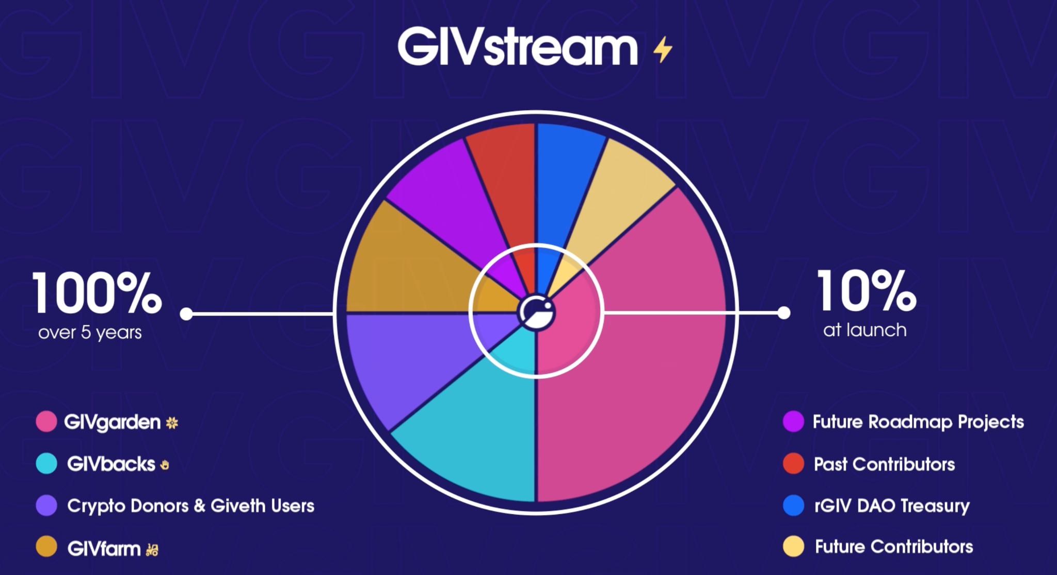
The GIVstream aligns community members with the long term success of Giveth and the GIVeconomy
With the GIVstream, anyone who adds value to the GIVeconomy receives GIV continuously for up to 5 years from the GIVeconomy launch date.
GIV is rewarded through participation in the GIVeconomy, part will be liquid and part will add to GIVstream flowrate. As the GIVeconomy grows & stabilizes, more GIV becomes liquid and available for everyone.
GIVstream flowrate is the rate (GIV/week) at which GIV becomes liquid.
On Gnosis Chain, GIVstream flowrates are given (or increased) by donating and getting GIVbacks, wrapping GIV to use in the GIVgarden, or staking in the GIVfarm. On Ethereum mainnet by providing mainnet liquidity and staking GIV or LP tokens in the GIVfarm on Mainnet.
The GIVstream nurtures the GIVeconomy at inception by having only 10% of the total supply of GIV liquid and transferrable to start.

Slide 20
The GIVgarden, the DAO governance platform
Giveth has chosen the Gardens DAO governance platform developed by 1hive to allow GIV token holders to manage the DAO configurations and allocate funds to projects that are aligned with its mission, vision and values.
The main tools used for governance in the GIVgarden are Conviction Voting and Tao Voting.
The unique feature of Conviction Voting is that, instead of voting yes or no on proposals, you stake GIV behind proposals that align with your values.
Tao Voting is a YES/NO decision making tool, with the option of delegation, that is used in the GIVgarden to make important, non-financial decisions for the DAO: updating DAO parameters, fixing bugs, adding new features to the DAO and/or for emergency situations such as an attack to the DAO treasury.

Slide 21
Stake tokens in the GIVfarm to grow rewards
Farms are available on either Ethereum Mainnet (ETH) or Gnosis Chain. Any farms you stake tokens into will yield GIV rewards and add to your GIVstream flowrate only for that corresponding chain.
3.5% of the total token supply, 35 Million GIV, has been allocated to the first GIVfarm round of 6 months, 65 million tokens are held in a multisig for future liquidity provision
GIVfarming the GIVgarden
The GIVeconomy implements a unique feature in its GIV Staking pool on Gnosis Chain. When you stake tokens in this farm, you are also wrapping those GIV in the GIVgarden.
This means that while collecting rewards from the GIVfarm, you also unlock voting power within the GIVgarden as long as you stay staked in this farm. Conversely, while wrapping GIV in the GIVgarden you are also staking tokens into the aforementioned GIV staking pool.
Pool
Tokens allocated
80GIV/20ETH Balancer on Mainnet
2.5 Million GIV
GIV Staking on Mainnet
2.5 Million GIV
GIV/HNY Honeyswap on Gnosis
10 Million GIV
GIV/WETH Sushiswap on Gnosis
2.5 Million GIV
GIVgardens Staking on Gnosis
7.5 Million GIV

Slide 22
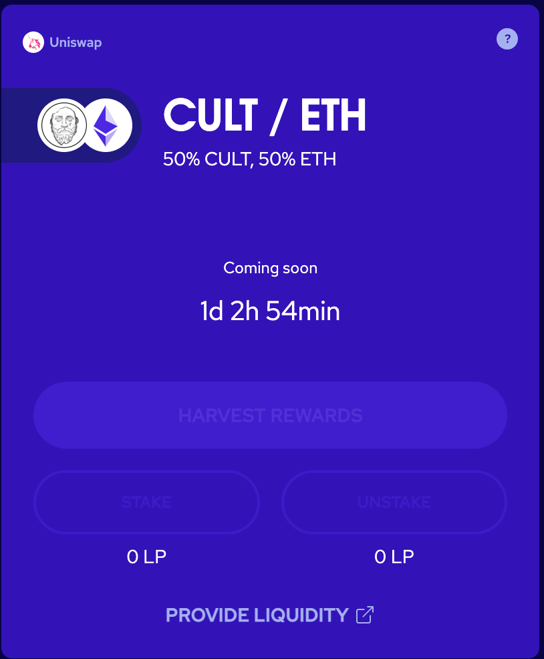
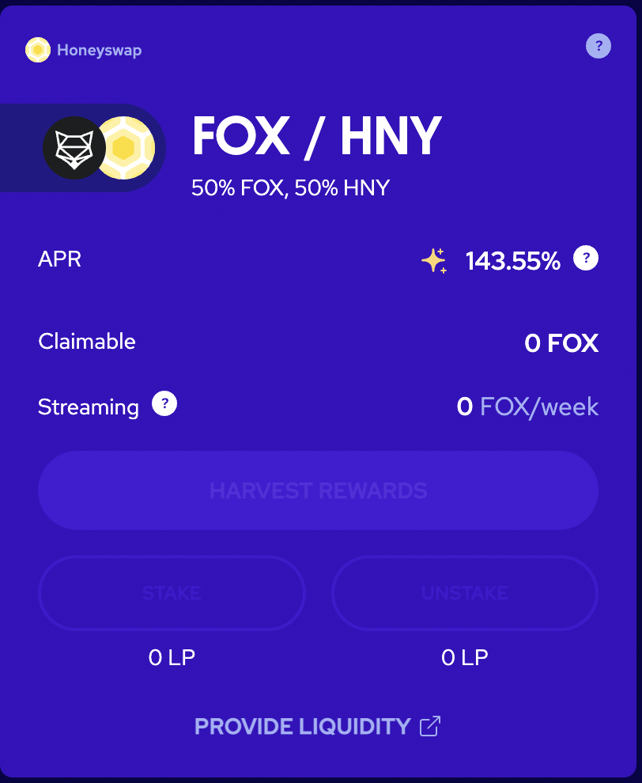
RegenFarms presents the next generation of ReFi liquidity mining
Using our contracts for the GIVfarm and the GIVstream, we are empowering other for-good DAOs to launch liquidity mining incentive programs, “RegenFarms”, with streams of their own.
How?
Utilizing the GIVstream, all rewards earned in the GIVfarm (until December 23, 2026) include some part liquid and some part streaming. This allows the GIVfarm to offer high APRs without creating excessive sell pressure. Thanks to the GIVstream, Giveth has pioneered an elegant evolution to traditional liquidity mining that offers lucrative rewards while attracting and rewarding long-term hodlers, and keeping participants invested in the project for years to come.
We are now offering this technology as a service to other Blockchain4Good DAOs!
Shapeshit and CULTDAO’s RegenFarm are open for deposits and earning rewards.

